Slide 1
Challenge Problems on Linear Functions

Slide 4
Amc 12 200712a

Slide 5
12a 2005 amc

Slide 8
2013 12b

Slide 9
2008 Hypatia

Slide 10
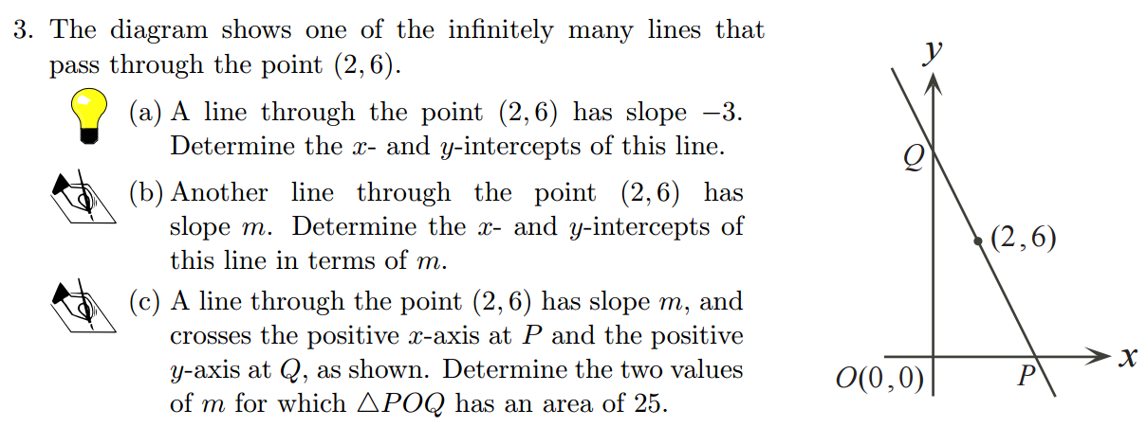
Galois 2012

